Slide 1
Theory of Computation
Theory of Computation Peer Instruction Lecture Slides by Dr. Cynthia Lee, UCSD are licensed under a Creative Commons Attribution-NonCommercial-ShareAlike 3.0 Unported License. Based on a work at www.peerinstruction4cs.org.

Slide 2
Today, How do we cope with Intractable Problems?
While P vs NP is still a mystery

Slide 3
Mapping Reducibility and NP-Completeness
There are a class of problems that are known to be in NP (can be solved in polynomial time using nondeterminism), but no deterministic polynomial time algorithm has ever been discovered to solve any of them
Boolean equation satisfiability
Traveling salesman
Various graph problems (Clique, Independent Set, …)
Various scheduling optimization problems
FreeCell (Windows game), Sudoku
Map coloring
Amazingly, all these problems can be to each other
This means that a polynomial-time solution to ONE is a polynomial time solution to ALL !!

Slide 4
NP-Complete Problems
No deterministic polynomial-time algorithm is known for any of the NP-complete problems
But there are many NP-complete problems that we need answers to!
Work-around:
Use randomization with a variety of sometimes very sophisticated optimization techniques to “guesstimate” the best answer we can
Examples: Genetic Algorithms, Simulated Annealing

Slide 5
Traveling Salesperson
Genetic algorithm iteratively searches for better and better solutions
Some offspring/mutations prove to be beneficial, others not
http://www.youtube.com/watch?v=94p5NUogClM
More genetic algorithm:
This one evolves car designs, with their “fitness” evaluated according to a particular terrain
http://megaswf.com/serve/102223

Slide 6
Reductions from ATM One More Example
Relevant both to Homework and Final Exam

Slide 7
How do we design Z?
I hope you have a better understanding now of the “big picture,” but now the question is, “OK, but how do I do that?”
For many languages you want to show are undecidable* (*options for some other languages are discussed on a later slide), there are a few simple steps:
Z(s):
(optional—it just makes it easier for me personally to think about Z’s design) reject any strings that are “extra” so you only have a few strings left to deal with
If needed, accept a few strings that will make L(Z) not have the property M_{T} tests for (you may not need step 2, if L(Z) = {} is an L(Z) that does not have the property M_{T} tests for)
Accept more strings if M(w) accepts (if M(w) rejects then reject)—make sure that step 3 will make L(Z) have the property M_{T} tests for (could involve accepting all strings if M(w) accepts—the following examples show this—or only accepting particular strings if M(w) accepts)
On the next two slides, Z is labeled with these 1,2,3 steps so you can see how it works

Slide 8
Thm. REGULAR_{TM} = {<M> | M is a TM and L(M) is a regular language} is undecidable
Proof by contradiction: (Reduce from A_{TM}.)
Assume REGULAR_{TM} is decidable by TM M_{R}. Use M_{R} to construct TM D_{ATM} that decides A_{TM}.
D_{ATM}(<M,w>):
Construct a TM Z:
Z(x):
(n/a)
If x has the form 0^{n}1^{n} for some n >=0, then accept.
Run M(w). If it accepts, accept. If it rejects, reject.
Run M_{R}(Z). If it accepts then accept, otherwise reject.
D_{ATM} decides ATM. [correctness argument]
But A_{TM} is undecidable, a contradiction. So the assumption is false and T is undecidable. QED.
What is L(Z)?
(a) Σ * (b) {“0^{n}1^{n}”} (c) { w | w = 0^{n}1^{n} for some n >= 0} if M(w) accepts, otherwise Σ *
(d) { w | w = 0^{n}1^{n} for some n >= 0} if M(w) does not accept, otherwise Σ * (e) { w | w = 0^{n}1^{n} for some n >= 0} if M(w) accepts, otherwise empty set
8

Slide 9
Thm. T = {<M> | M is a TM that accepts w^{R} whenever it accepts w} is undecidable
Proof by contradiction: (Reduce from A_{TM}.)
Assume T is decidable by TM M_{T}. Use M_{T} to construct TM D_{ATM} that decides A_{TM}.
D_{ATM}(<M,w>):
String Z = “Z(x): \n” +
“If x != “01” and x != “10” then reject \n” +
“If x == “01” accept \n” +
“ ??? ”;
Run M_{T}(Z). If it accepts then accept, otherwise reject.
But A_{TM} is undecidable, a contradiction. So the assumption is false and T is undecidable. QED.
How do we finish Z?
Run M(w), if it accepts then accept. If it rejects then reject (might loop in which case obviously Z loops).
Run M(w), if it accepts then reject. If it rejects then accept (might loop in which case obviously Z loops).
9

Slide 10
Reviewing for The final exam
Review

Slide 11
Looking Ahead to the Final Exam
DFAs, NFAs, REs, PDAs, Grammars: general understanding
Closure proofs (for all language classes)
Pumping Lemma proofs
Prove a language is decidable/r.e./co-r.e. (write TM code, maybe use something from the “toolkit” from Section 4.1, like problem #2, be careful to avoid loops and lexicographic/alphabetic issue)
Prove a language is undecidable by reduction from some other language (like problem #4 on HW#4)
Prove a language is undecidable by reduction from A_{TM} (this is similar to #5 on this list, but when reducing from A_{TM} specifically, there are some special tricks to know—we’ll do many examples on Tuesday)

Slide 12
Topics not on the exam
Tuesday’s lecture on P/NP was largely enrichment
You will not be asked to prove from scratch that A B
You should know basic facts about what P and NP are, and why it’s a “Big Deal”
PCP (5.2 in the book), entire Chapter 6
Reductions via computation histories, writing proofs using linear-bounded automata
Exclusions for midterm still apply (i.e., no GNFA, no changing grammar to CNF)

Slide 13
Terminology check: “Run A_{TM} on input M,w”
What should you write instead of the above? (Assume the context is trying to test if M accepts w)
“Run A_{TM} on input <M,w>”
“Run <A_{TM}> on input <M,w>”
“Run M_{ATM}, a TM that recognizes language A_{TM,} on input M,w”
“Run M_{ATM}, a TM that recognizes language A_{TM,} on input <M,w>”

Slide 14
Study suggestions
Review lecture slides
T/F, multiple choice, drawing taken mostly from lecture
Review homework
Proofs taken from homework
Some T/F, multiple choice questions incorporate proof concepts from homework
Practice exam
Book is there if you need more clarification of a topic
Poring over every detail of Chapters 1-5,7 in their entirety likely to be a very unproductive use of time

Slide 15
Final Exam Whole-Course REview
Review

Slide 16
True (a) or False (b)?
Language A = {w | “0101” is a substring of w}. It is possible to build a TM that recognizes (but does not decide) A.

Slide 17
True (a) or False (b)?
Language A = {w | the first character of w is ‘1’ and the last character is ‘0’}. It is possible to build a TM that recognizes (but does not decide) A.

Slide 18
What did we do in this class?
Weak = limited uses
Powerful = versatile
Venn Diagram
We examined a series of abstracted models of computation machines
Started with the most limited
Moved towards the most versatile
Along the way,
Learned how to use each model as a handy tool in your programming life (e.g. RegExp)
Became intimate with the contours of each model’s limitations and powers
Proved things about the limitations, about the powers, and about the relationships between models
DFA TM

Slide 19
Remember this slide?

Slide 20
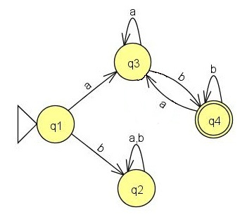
Which is the best description of the language recognized by the DFA M₂? (Σ = {a,b})
Starts with b and ends with b
Starts with a and ends with b
b‘s followed by a’s
M₂:

Slide 21
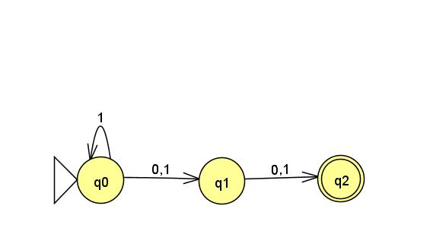
Tracing in an NFA
“100”
What are the two sequences of states on the input “100”?
(q0,q0,q1,q2[accept]), (q0,q1,q2[accept])
(q0,q0,q1,q2[accept]), (q0,q1,q2[reject])
(q0,q0,q1,q2[reject]), (q0,q1,q2[reject])

Slide 22
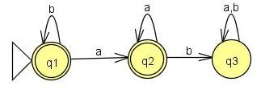
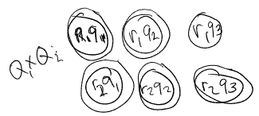
Thm. The class of regular languages is closed under the union operation.
Our working example:
A generalized proof form:
Given two regular languages L1, L2, with DFAs M1, M2
M1 = (Q1,Σ,δ1,q₀1,F1)
M2 = (Q2,Σ,δ2, q₀2,F2)
We want to construct a DFA M = (Q,Σ,δ, q₀,F), s.t.:
Q = Q1 x Q2
δ =
q₀ =
F =
M recognizes L1 U L2
A DFA recognizes L1 U L2, then L1 U L2 must be regular
WHERE DO M1, M2 COME FROM? WHY CAN WE ASSUME THEY EXIST?
Finish this DFA
 | a | b
(r1,q1) | (r2,q2) | (r2,q1)
(r1,q2) | (r2,q2) | (r2,q3)
(r1,q3) | (r2,q3) | (r2,q3)
(r2,q1) | (r1,q2) | (r1,q1)
(r2,q2) | (r1,q2) | (r1,q3)
(r2,q3) | (r1,q3) | (r1,q3)

Slide 23
Thm. The class of regular languages is closed under the union operation.
Our working example:
A generalized proof form:
Given two regular languages L1, L2, with DFAs M1, M2
M1 = (Q1,Σ,δ1,q₀1,F1)
M2 = (Q2,Σ,δ2, q₀2,F2)
We want to construct a DFA M = (Q,Σ,δ, q₀,F), s.t.:
Q = Q1 x Q2
δ =
q₀ =
F =
M recognizes L1 U L2
A DFA recognizes L1 U L2, then L1 U L2 must be regular
Finish this DFA
Finish this DFA
q0 = (r1,q1)
q0 = (q₀1, q₀2)
q0 = {(r1,q1)}
None of the above
 | a | b
(r1,q1) | (r2,q2) | (r2,q1)
(r1,q2) | (r2,q2) | (r2,q3)
(r1,q3) | (r2,q3) | (r2,q3)
(r2,q1) | (r1,q2) | (r1,q1)
(r2,q2) | (r1,q2) | (r1,q3)
(r2,q3) | (r1,q3) | (r1,q3)

Slide 24
Thm. The class of regular languages is closed under the union operation.
Our working example:
A generalized proof form:
Given two regular languages L1, L2, with DFAs M1, M2
M1 = (Q1,Σ,δ1,q₀1,F1)
M2 = (Q2,Σ,δ2, q₀2,F2)
We want to construct a DFA M = (Q,Σ,δ, q₀,F), s.t.:
Q = Q1 x Q2
δ =
q₀ =
F =
M recognizes L1 U L2
A DFA recognizes L1 U L2, then L1 U L2 must be regular
Finish this DFA
Finish this DFA
δ: Q1 x Q2 → Q
δ: Q1 x Q2 x Σ → Q
δ((x,y),c) = (δ1(x,c), δ2(y,c))
δ((q1,r1), a) = (r2,q2)
None of the above
 | a | b
(r1,q1) | (r2,q2) | (r2,q1)
(r1,q2) | (r2,q2) | (r2,q3)
(r1,q3) | (r2,q3) | (r2,q3)
(r2,q1) | (r1,q2) | (r1,q1)
(r2,q2) | (r1,q2) | (r1,q3)
(r2,q3) | (r1,q3) | (r1,q3)

Slide 25
Thm. The class of regular languages is closed under the union operation.
Our working example:
A generalized proof form:
Given two regular languages L1, L2, with DFAs M1, M2
M1 = (Q1,Σ,δ1,q₀1,F1)
M2 = (Q2,Σ,δ2, q₀2,F2)
We want to construct a DFA M = (Q,Σ,δ, q₀,F), s.t.:
Q = Q1 x Q2
δ =
q₀ =
F =
M recognizes L1 U L2
A DFA recognizes L1 U L2, then L1 U L2 must be regular
Finish this DFA
Finish this DFA
F = {(r1,q1), (r1,q2), (r2,q1), (r2q2), (r2,q3)}
F = F1 x F2
F = F1 U F2
F = {(x,y) in Q | x in F1 or y in F2}
None of the above
 | a | b
(r1,q1) | (r2,q2) | (r2,q1)
(r1,q2) | (r2,q2) | (r2,q3)
(r1,q3) | (r2,q3) | (r2,q3)
(r2,q1) | (r1,q2) | (r1,q1)
(r2,q2) | (r1,q2) | (r1,q3)
(r2,q3) | (r1,q3) | (r1,q3)

Slide 26
Regular Expressions
Let L be the language of this regular expression:
((a U Ø)⁺b*)*
Which of the following is NOT true of L?
Some strings in L have equal numbers of a’s and b’s
All strings in L have more b’s than a’s
L contains “aaaaaa”
a‘s never follow b’s in any string in L
None of the above

Slide 27
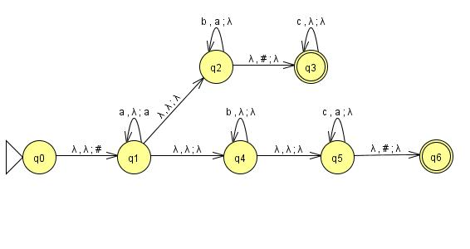
Tracing in a Pushdown Automaton
e
top of stack bottom of stack →
Which choice depicts a stack state that occurs at some point during the successful* processing of the string “abbbc” on the given PDA?
a | b | b | b | c | #
None of the above
b | b | b
# | b | b | b
# | λ
* Ignore all nondeterministic paths that end in rejecting/getting stuck.

Slide 28
Executing a Transition, “yields”
Suppose we have at TM s.t. Γ={0,1,_}, Q = {q_{x} | 1≤x≤7} U {q_{acc},q_{rej}}, and the transition function includes rules δ(q₁,1) = (q₃,0,R) and δ(q₁,0) = (q₃,1,L). We also have strings x,v,x,y in Γ*. Which configuration does the current configuration, x0q₁1y, yield?
xq₃00y
x01q₃y
x00q₃y
xq₃11y
None of the above or more than one of the above

Slide 29
P = NP ????????
P = languages decidable in polynomial number of steps on deterministic TM, NP = languages decidable in polynomial number of steps on non-deterministic TM
P = NP? Perhaps the greatest theoretical computation question of our time
Most people suspect no, but it has never been proven…
Bunch of problems in NP, don’t know if they are in P:
Boolean equation satisfiability
Traveling salesman
Various graph problems (Clique, Independent Set, …)
Various scheduling optimization problems
FreeCell (Windows game), Sudoku
Map coloring
Two Possible Venn Diagrams

