Slide 1
CSE 12 – Basic Data Structures
CS2 in Java Peer Instruction Materials by Cynthia Lee is licensed under a Creative Commons Attribution-NonCommercial 4.0 International License. Based on a work at http://peerinstruction4cs.org. Permissions beyond the scope of this license may be available at http://peerinstruction4cs.org.
Cynthia Bailey Lee
Some slides and figures adapted from Paul Kube’s CSE 12

Slide 2
Big O Survey Results

Slide 3
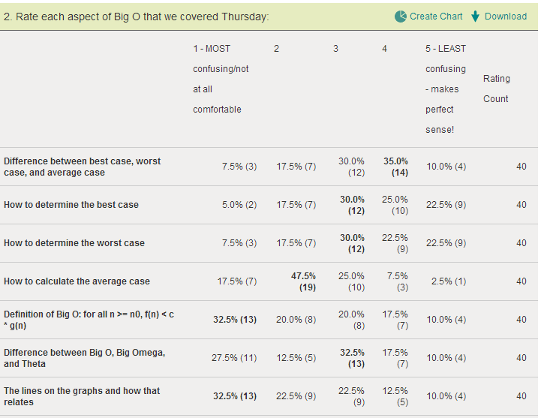

Slide 4
Today’s Topics
Algorithm analysis
Worst case vs best case vs average case - Done
Big-O vs Ω vs Θ - Review
Graphs - Review
Big numbers - Done
Shortcuts for calculating - New
Extracting time cost from example code - New
Linked Lists - New topic for today

Slide 5
Big-O
Interpreting graphs

Slide 6
f(n) = O(g(n)), if there are positive constants c and n₀ such that f(n) ≤ c * g(n) for all n ≥ n₀.
Obviously f₂ = O(f₁) because f₁ > f₂ (after about n=10, so we set n₀ = 10)
f₁ is clearly an upper bound on f₂ and that’s what big-O is all about
But f₁ = O(f₂) as well!
We just have to use the “c” to adjust so f₂ that it moves above f₁
f₁
f₂

Slide 7
f(n) = O(g(n)), if there are positive constants c and n₀ such that f(n) ≤ c * g(n) for all n ≥ n₀.
Obviously f₂ = O(f₁) because f₁ > f₂ (after about n=10, so we set n₀ = 10)
f₁ is clearly an upper bound on f₂ and that’s what big-O is all about
But f₁ = O(f₂) as well!
We just have to use the “c” to adjust so f₂ that it moves above f₁
c * f₂
f₁
f₂

Slide 8
f₁ = O(f₃) but f₃ ≠ O(f₁)
There is no way to pick a c that would make an O(n) function (f₁) stay above an O(n²) function (f₃).
f₃
f₁
f₂

Slide 9
Shortcuts for calculating
Big-O analysis starting with a function characterizing the growth in cost of the algorithm

Slide 10
Let f(n) = 3 log₂ n + 4 n log₂ n + n
Which of the following is true?
f(n) = O(log₂n)
f(n) = O(nlog₂n)
f(n) = O(n²)
f(n) = O(n)
Other/none/more

Slide 11
Let f(n) = 546 + 34n + 2n²
Which of the following is true?
f(n) = O(2^{n})
f(n) = O(n²)
f(n) = O(n)
f(n) = O(n³)
Other/none/more

Slide 12
Let f(n) = 2^{n} + 14n² + 4n³
Which of the following is true?
f(n) = O(2^{n})
f(n) = O(n²)
f(n) = O(n)
f(n) = O(n³)
Other/none/more

Slide 13
Let f(n) = 100
Which of the following is true?
f(n) = O(2^{n})
f(n) = O(n²)
f(n) = O(n)
f(n) = O(n¹⁰⁰)
Other/none/more

Slide 14
Extracting time cost from example code
Algorithm analysis starting with the algorithm

Slide 15
A student has counted how many times we perform each line of code
Is the count 3n+5:
the best case?
the worst case?
the average case?
Other/none/more
 | Statements | Cost
1 | float findAvg ( int []grades ){
2 | float sum = 0; | 1
3 | int count = 0; | 1
4 | while ( count < grades.length ) { | n + 1
5 | sum += grades[count]; | n
6 | count++; | n
7 | }
8 | if ( grades.length > 0 ) | 1
9 | return sum / grades.length;
10 | else | 1
11 | return 0.0f;
12 | }
ALL |  | 3n+5

Slide 16
Count how many times each line executes, then which O( ) most accurately characterizes the growth?
Line #
int maxDifference(int[] arr){
max = 0;
for (int i=0; i<arr.length; i++) {
for (int j=0; j<arr.length; j++) {
if (arr[i] – arr[j] > max)
max = arr[i] – arr[j];
}
}
return max;
}
1
2
3
4
5
6
7
8
9
f(n) = O(2^{n})
f(n) = O(n²)
f(n) = O(n)
f(n) = O(n³)
Other/none/more
(assume n = arr.length)

Slide 17
Count how many times each line executes, then say which O( ) statement(s) is(are) true.
Line #
int maxDifference(int[] arr){
max = 0;
for (int i=0; i<arr.length; i++) {
for (int j=0; j<arr.length; j++) {
if (arr[i] – arr[j] > max)
max = arr[i] – arr[j];
}
}
return max;
}
1
2
3
4
5
6
7
8
9
f(n) = O(2^{n})
f(n) = O(n²)
f(n) = O(n)
f(n) = O(n³)
Other/none/more
(assume n = arr.length)

Slide 18
Linked Lists

Slide 19
Reading Quiz!
Elements of an array are ____ in memory whereas elements of a singly linked list are not (although sometimes they can be), requiring each node element to contain ____
scattered, an index
adjacent, an index
scattered, a pointer to the next element
adjacent, a pointer to the next element

Slide 20
Reading Quiz!
A node in a singly linked list is the last element if the pointer contains ____
1
-1
null
The address of the first element

Slide 21
Reading Quiz!
The capacity of an array is ____ whereas the capacity of a linked list ____
added incrementally, is defined at one time
defined at one time, increases incrementally

Slide 22
Linked list of Objects
ublic class List12<E> implements java.util.List<E>
public class LinkedList {
private Node head;
private int size;
public class Node {
public Object data;
public Node next;
public Node(Object d, Node n) {
data = d;
next = n;
}
}
YOUR HW ONE IS SLIGHTLY DIFFERENT!
public class List12<E> implements java.util.List<E>

Slide 23
Complete the code...
In the next set of slides, we will explore some common misunderstandings about linked lists by asking you to identify missing lines of code in linked list methods
This will be slightly different from your HW, to give you the idea but not do it for you ☺
Methods we will look at are:
addFirst(Object o)
addLast(Object o)
remove(Object o)

Slide 24
How our class looks in memory
next
data
next
data
next
data
next
data
next
data
next
data
next
data
ls
head
next
data
size
4
15
15
77
40
77
10
40
10
- “head” points to first node
- We keep track of size
Null next pointer
means “end of the list”
head
NULL

Slide 25
addFirst (Object o)
head
NULL
addLast (Object o)
head
NULL
remove (Object o)
head
NULL

Slide 26
What line of code will correctly complete this method?
public void addFirst (Object newItem) {
Node newNode = new Node(newItem, head);
________________________;
}
A) No line is needed. The code is correct as written.
B) head = head.next;
C) head = newNode;
D) newNode.next = head;
Question to think about/discuss: what is the purpose or effect of passing head as an argument here?
Notes:
C) . Trace the execution of the code with a small visual example.

Slide 27
What replaces the XXXXXX?
public void addLast (Object newItem) {
if (head == null)
head = new Node(newItem, null);
else {
Node current = head;
while (XXXXXX){ current = current.next; }
current.next = new Node(newItem, null);
}
}
A) current == head
B) current != null
C) current.next != null
D) head != null
Notes:
Correct answer C) the next pointer of the last item in the list is null.

Slide 28
What is worst case time complexity of addFirst and addLast?
 | addFirst | addLast
A) | O(1) | O(1)
B) | O(1) | O(n)
C) | O(n) | O(1)
D) | O(n) | O(n)
E) Other/none/more
Notes:
Correct Answer B)

Slide 29
Removal from Linked List
public boolean remove (Object item){
// Removes the first instance of the object item
// from the calling list, if present.
// Returns true if item is present, false if not.
...
}
head
NULL

Slide 30
Suppose we have a reference (current) to the node containing the item to be removed.
What additional information do we need to successfully remove the node?
A) Nothing additional.
B) A reference to the node immediately prior to the deleted node.
C) A reference to the node immediately after the node to be deleted.
D) Both B and C.
head
current (we want to remove this one)
NULL
Notes:
Correct Answer B)
Students might think you also need C (pointer to the node after) not realizing that you have that reference from current.next

Slide 31
Interview questions you might encounter
Q. How do you remove an element from a singly linked list without having a pointer to the previous element?
Q. How reverse a singly linked list in place?

Slide 32
Other topics/issues to think about
Remove all instances
Copying a list
What does equality mean of two lists/testing for equality
Iterators

