Slide 1
CSE 12 – Basic Data Structures
CS2 in Java Peer Instruction Materials by Cynthia Lee is licensed under a Creative Commons Attribution-NonCommercial 4.0 International License. Based on a work at http://peerinstruction4cs.org. Permissions beyond the scope of this license may be available at http://peerinstruction4cs.org.
Cynthia Bailey Lee
Some slides and figures adapted from Paul Kube’s CSE 12

Slide 2
Today’s Topics
Recursively defined functions vs. “normal” functions
Factorial
Fibonacci
Dynamic programming

Slide 3
Reading quiz!

Slide 4
Reading Quiz! A queue is also called a...?
If a function F calls function B, and B calls function C, and C calls F. We say F is ____
Directly recursive
Indirectly recursive
Both A and B
None of the above
Notes:
(reading question. Answer: C)

Slide 5
Reading Quiz! A queue is also called a...?
Which of the following statements about the base part of a recursive definition is/are true?
Keeps the definition from being completely circular
Recursively applies the definition to a smaller version of the problem
Involves the smallest possible version of the problem
Both A and C
Notes:
(reading question. Answer: C)

Slide 6
Reading Quiz! A queue is also called a...?
Consider the following function:
long factorial ( int n ) {
if ( n == 1 ) return 1;
return n * factorial( n – 1 );
}
The base case is represented by line __ and the recursive case by line __
1, 3
3, 2
2, 3
2, 4
Notes:
(reading question. Answer: C)

Slide 7
Recursively defined functions vs “normal” functions

Slide 8
Recursively defined functions vs “normal” functions
Here’s a function f:
f(n) =
If n < 1, 1
If n > 1, n³ + 5n +7

Slide 9
Recursively defined functions vs “normal” functions
Here’s a function f:
f(n) =
If n < 1, 1
If n > 1, n³ + 5n +7
Let’s work an example:
What is f(10)?
10 > 1, so we apply the second part of the definition
1000 + 50 + 7 = 1057

Slide 10
Recursively defined functions vs “normal” functions
Recursive Definition
n! =
if n is 1, then n! = 1
if n > 1, then n! = n * (n – 1)!

Slide 11
Recursively defined functions vs “normal” functions
Recursive Definition
n! =
if n is 1, then n! = 1
if n > 1, then n! = n * (n – 1)!
Let’s work an example
What is 10! ?
10 > 1, so we apply the second part of the definition
10! = 10 * 9!
Well wait, we don’t have an answer yet!

Slide 12
Factorial!
!!

Slide 13
Factorial!
Recursive definition
Recursive code
n! =
if n is 1, then n! = 1
if n > 1, then n! = n * (n – 1)!
long factorial ( int n ) {
S.o.p(n);
if (n==1) return 1;
return n*factorial(n–1);
}
What is the third thing printed when we call factorial(10)?
2
3
7
8
Other/none/more
Note: “S.o.p” is short for System.out.println.

Slide 14
Factorial!
Recursive definition
Recursive code
n! =
if n is 1, then n! = 1
if n > 1, then n! = n * (n – 1)!
long factorial ( int n ) {
S.o.p(n);
if (n==1) return 1;
return n*factorial(n–1);
}
What is the first thing ever returned when we call factorial(10)? (first return statement to actually execute)
1
2
9
10
Other/none/more than one
Note: “S.o.p” is short for System.out.println.

Slide 15
Factorial!
Recursive definition
Recursive code
n! =
if n is 1, then n! = 1
if n > 1, then n! = n * (n – 1)!
long factorial ( int n ) {
S.o.p(n);
if (n==1) return 1;
return n*factorial(n–1);
}
What is the second thing ever returned when we call factorial(10)? (first return statement to actually execute)
1
2
10
90
Other/none/more than one
Note: “S.o.p” is short for System.out.println.

Slide 16
Factorial!
Recursive definition
Recursive code
n! =
if n is 1, then n! = 1
if n > 1, then n! = n * (n – 1)!
long factorial ( int n ) {
S.o.p(n);
if (n==1) return 1;
return n*factorial(n–1);
}
What is the third thing ever returned when we call factorial(10)? (first return statement to actually execute)
1
2
3
10
Other/none/more than one
Note: “S.o.p” is short for System.out.println.

Slide 17
How does this look in memory?
Memory

Slide 18
How does this look in memory?
Memory

Slide 19
How does this look in memory?
Memory Before
Memory After
Example code
int [] myarr;
myarr = new int[100];

Slide 20
How does this look in memory?
Memory Before
Memory WHILE equals() is running
Example code
str1.equals(str2);

Slide 21
How does this look in memory?
Memory
Recursive code
long factorial ( int n ) {
S.o.p(n);
if (n==1) return 1;
return n*factorial(n–1);
}
void mymethod(){
int x = 10;
long xfac = 0;
nfac = factorial(10);
}
Note: “S.o.p” is short for System.out.println.

Slide 22
How does this look in memory?
Memory
Recursive code
long factorial ( int n ) {
S.o.p(n);
if (n==1) return 1;
return n*factorial(n–1);
}
void mymethod(){
int x = 10;
long xfac = 0;
nfac = factorial(10);
}
Note: “S.o.p” is short for System.out.println.

Slide 23
How does this look in memory?
Memory
Recursive code
long factorial ( int n ) {
S.o.p(n);
if (n==1) return 1;
return n*factorial(n–1);
}
void mymethod(){
int x = 10;
long xfac = 0;
nfac = factorial(10);
}
Note: “S.o.p” is short for System.out.println.

Slide 24
How does this look in memory?
Memory
Recursive code
long factorial ( int n ) {
S.o.p(n);
if (n==1) return 1;
return n*factorial(n–1);
}
void mymethod(){
int x = 10;
long xfac = 0;
nfac = factorial(10);
}
Note: “S.o.p” is short for System.out.println.

Slide 25
How does this look in memory?
Memory
Recursive code
long factorial ( int n ) {
S.o.p(n);
if (n==1) return 1;
return n*factorial(n–1);
}
How many different values of n will be on the stack at the same time, at most, during the execution of factorial(10)?
(A) 1 (B) 2 (C) 9 (D) 10 (E) other/none
Note: “S.o.p” is short for System.out.println.

Slide 26
How does this look in memory?
Memory
Recursive code
long factorial ( int n ) {
S.o.p(n);
if (n==1) return 1;
return n*factorial(n–1);
}
How many different values of n will be on the stack at the same time, at most, during the execution of factorial(10)?
(A) 1 (B) 2 (C) 9 (D) 10 (E) other/none
Note: “S.o.p” is short for System.out.println.

Slide 27
Factorial!
Iterative version
Recursive version
long factorial(int n)
{
long f = 1;
while ( n > 1 ) {
f = f * n;
n = n – 1;
}
return f;
}
long factorial(int n)
{
if (n==1) return 1;
return n*factorial(n-1);
}
NOTE: sometimes iterative can be much faster because it doesn’t have to push and pop stack frames. Method calls have overhead in terms of space and time to set up and tear down.

Slide 28
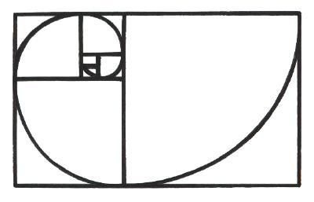
Fibonacci

Slide 29
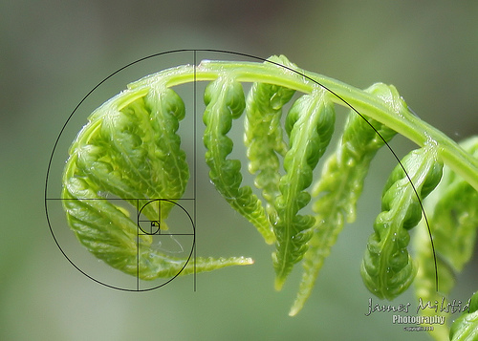
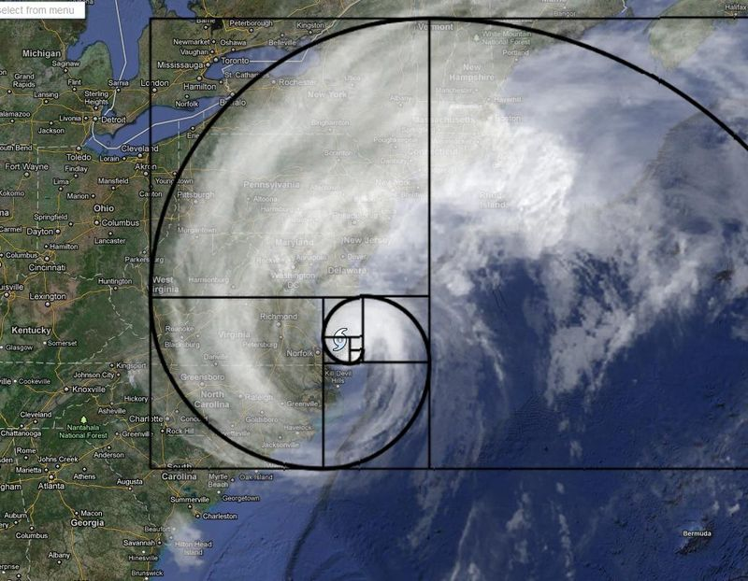
Fibonacci
f(1) = 1
f(2) = 1
For all n > 2:
f(n) = f(n-1) + f(n-2)

Slide 30
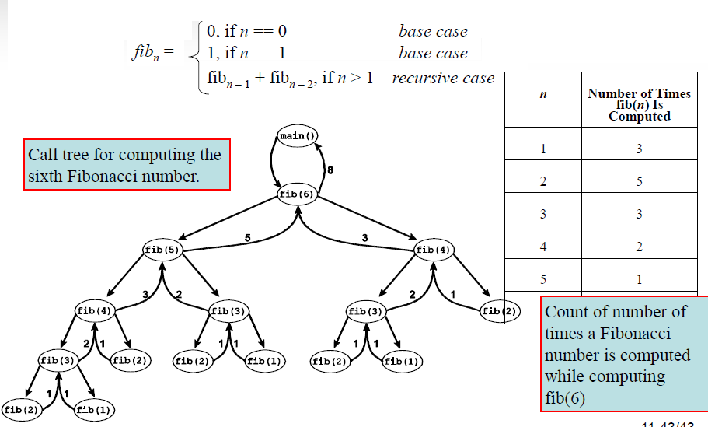
Fibonacci

Slide 31
How many times do we calculate fib₂ while calculating fib₇?
A. 5 D. 10
B. 7 E. Other
C. 8

Slide 32
Dynamic Programming
All that repetition of calculation is wasteful!
Dynamic Programming is keeping intermediate results in a table, so we don’t have to recalculate them
Adds some space cost, but reduces time cost for some algorithms

