Slide 1
CSE 12 – Basic Data Structures
CS2 in Java Peer Instruction Materials by Cynthia Lee is licensed under a Creative Commons Attribution-NonCommercial 4.0 International License. Based on a work at http://peerinstruction4cs.org. Permissions beyond the scope of this license may be available at http://peerinstruction4cs.org.
Cynthia Bailey Lee
Some slides and figures adapted from Paul Kube’s CSE 12

Slide 2
Today’s Topics
Priority queues
Unsorted link list implementation
Sorted link list implementation
Heap implementation

Slide 3
Reading quiz!

Slide 4
A queue is a FIFO data structure whereas a priority queue is _____ data structure.
READING QUIZ!
Also a FIFO
A LIFO
An HPIFO
An APIFO

Slide 5
The ____ of a tree is a node with no parent.
READING QUIZ!
Orphan
Leaf node
Super node
Root

Slide 6
For assignment P4, when the add() method is called with a non-null argument, and the size of the Heap12 is equal to the length of its backing store, what should be done?
READING QUIZ!
Throw an exception
Double the length of the backing store array
Create a new node and add it to the end of the backing store linked list
Return false

Slide 7
Priority Queues

Slide 8
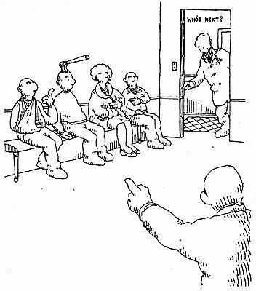
Priority Queue
Emergency Department waiting room operates as a priority queue
Patients sorted according to seriousness, NOT how long they have waited

Slide 9
Priority queue implementation options
Unsorted linked list
Insert new element in front
Remove by searching list for highest-priority item
Sorted linked list
Always insert new elements where they go in priority-sorted order
Remove from front

Slide 10
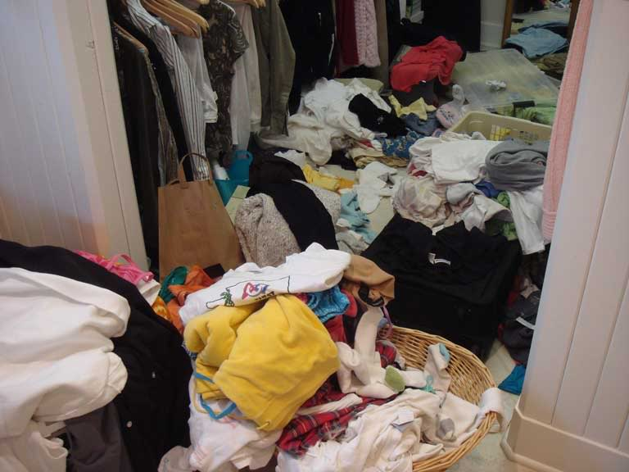
Unsorted linked list
Priority queue implementations
Add is FAST
Just throw it in the list at the front
O(1)
Remove/peek is SLOW
Hard to find item the highest priority item—could be anywhere
O(N)

Slide 11
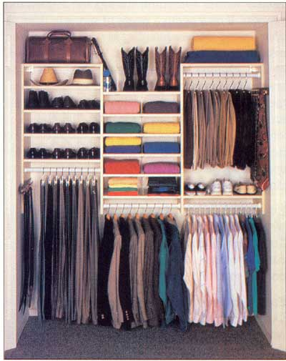
Sorted linked list
Priority queue implementations
Add is SLOW
Need to step through the list to find where item goes in priority-sorted order
O(N)
Remove/peek is FAST
Easy to find item you are looking for (first in list)
O(1)

Slide 12
We want the best of both
Priority queue implementations
Fast add AND fast remove/peek
We will investigate trees as a way to do this

Slide 13
Binary trees

Slide 14
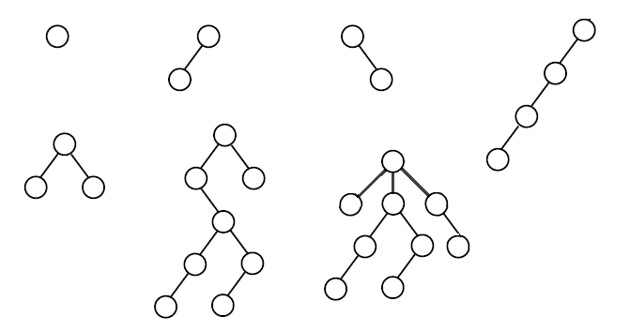
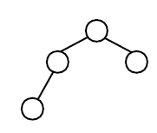
How many of these are valid binary trees?
0-3
4
5
6
7-8

Slide 15
A node object for binary trees
Similar to a linked list node, it contains a pointer to data, and a pointer to the next elements
Whereas a linked list node has just one next pointer, a binary node tree has two child pointers, left and right
data:
left:
right:

Slide 16
A node object for binary trees
Similar to a linked list node, it contains a pointer to data, and a pointer to the next elements
Whereas a linked list node has just one next pointer, a binary node tree has two child pointers, left and right
data:
left:
right:
data:
left:
right:
data:
left:
right:

Slide 17
Heaps

Slide 18
Heaps
Heaps are one kind of binary tree
They have a few special restrictions, in addition to the usual binary tree ADT:
Must be complete
Ordering of data must obey heap property
Min-heap version: a parent’s data is always ≤ its children’s data
Max-heap version: a parent’s data is always ≥ its children’s data

Slide 19
How many of these could be valid heaps?
0-1
2
3
4
5-8

Slide 20
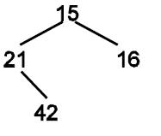
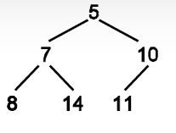
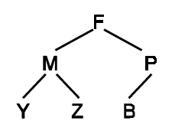
How many of these are valid min-heaps?
0
1
2
3

Slide 21
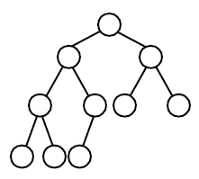
In how many places could the largest number in this max-heap be located ?
0-2
3-4
5-6
7-8

Slide 22
In how many places could the largest number in this max-heap be located ?
0-2
3-4
5-6
7-8
Max heaps are perfect for priority queues, because we always know where the highest priority item is

Slide 23
In how many places could the number 35 be located in this min-heap?
0-2
3-4
5-6
7-8
5
15

Slide 24
In how many places could the number 35 be located in this min-heap?
0-2
3-4
5-6
7-8
5
15
Min heaps also good for priority queues, if “high priority” in your system actually means low value
(i.e. 1 means most important)

Slide 25
Heap in an array

Slide 26
Heap in an array
data:
left:
right:
We actually do NOT typically use a node object to implement heaps
Because they must be complete, they fit nicely into an array, so we usually do that

Slide 27
Heap in an array
For tree of height h, array length is 2^{h}-1
For a node in array index i:
Parent is at array index:
i – 2
i / 2
(i – 1)/2
2i

Slide 28
Heap in an array
For tree of height h, array length is 2^{h}-1
For a node in array index i:
Left child is at array index:
i +1
i + 2
2i
2i + 1

Slide 29
Heap in an array
For tree of height h, array length is 2^{h}-1
For a node in array index i:
Parent is at array index: (i – 1)/2
Left child is at array index: 2i + 1
Right child is at array index: 2i + 2

Slide 30
Heap insert and delete

Slide 31
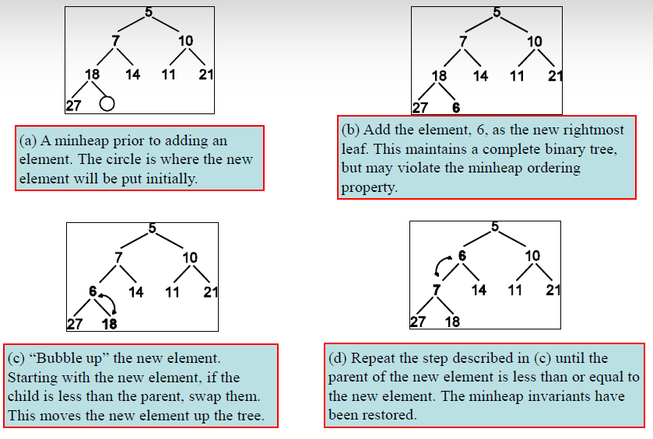
Heap insert

Slide 32
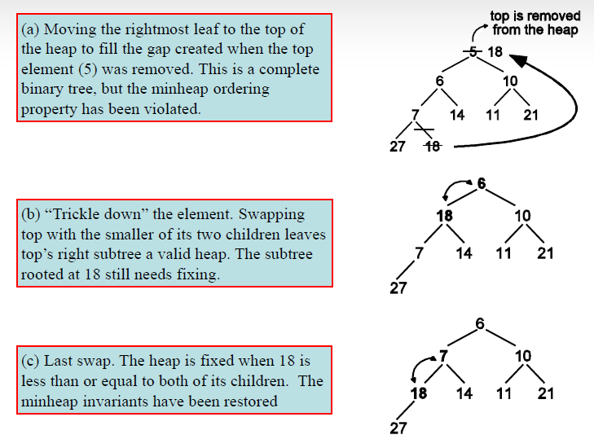
Heap delete

Slide 33
TRUE OR FALSE
There is only one configuration of a valid min-heap containing the elements {34, 22, 3, 9, 18}
TRUE
FALSE

Slide 34
Time cost
What is the worst-case time cost for each heap operation: Add, Remove, Peek?
O(n), O(1), O(1)
O(logn), O(logn), O(1)
O(n), O(logn), O(logn)
Other/none/more

Slide 35
Heapsort

Slide 36
Heapsort is super easy
Insert unsorted elements one at a time into a heap until all are added
Remove them from the heap one at a time (we will always be removing the next biggest item, for max-heap; or next smallest item, for min-heap)
THAT’S IT!

Slide 37
Implementing heapsort
Devil’s in the details

Slide 38
We can do the entire heapsort in place in one array
Unlike mergesort, we don’t need a separate array for our workspace
We can do it all in place in one array (the same array we were given as input)

Slide 39
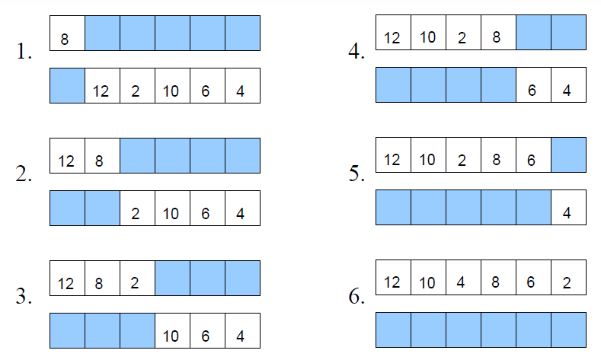
Build heap by inserting elements one at a time:

Slide 40
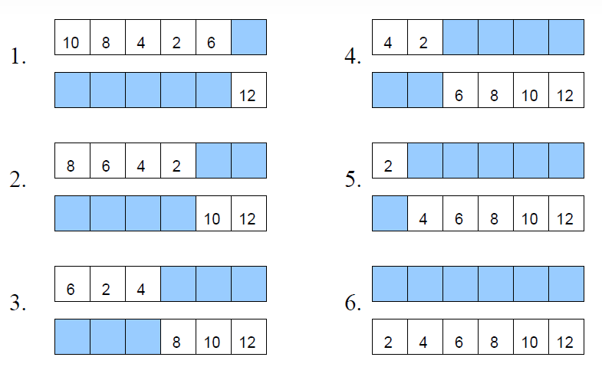
Sort array by removing elements one at a time:

Slide 41
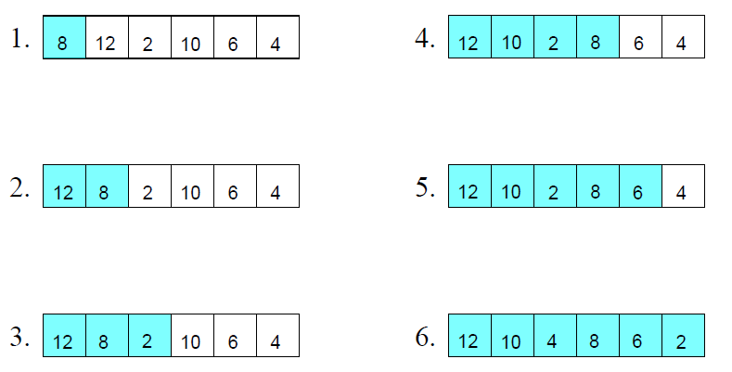
Build heap by inserting elements one at a time IN PLACE:

Slide 42
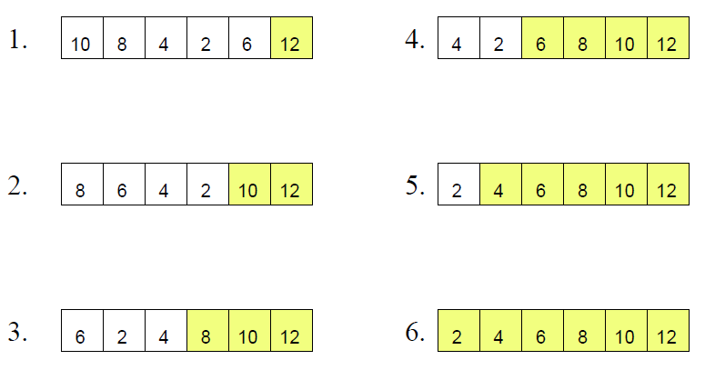
Sort array by removing elements one at a time IN PLACE:

