Slide 1
CSE 20 – Discrete Mathematics
Peer Instruction in Discrete Mathematics by Cynthia Leeis licensed under a Creative Commons Attribution-NonCommercial-ShareAlike 4.0 International License. Based on a work at http://peerinstruction4cs.org. Permissions beyond the scope of this license may be available at http://peerinstruction4cs.org.
Dr. Cynthia Bailey Lee
Dr. Shachar Lovett

Slide 2
Today’s Topics:
Predicate Quantifiers
Paradoxes

Slide 3
1. Predicate Quantification
Sometimes and all the time.

Slide 4
I’m going to assume you know this from the reading:
“For all even numbers x and y, the sum of x and y is also even.” ≡
$∀x,y∈E, \left(x+y\right)∈E$
“There exists an integer g such that g is greater than 5.” ≡
$∃g∈Z s.t. g>5$

Slide 5
We’re going to focus on:
“Nested” quantifiers/more than one quantifier
General strategy for proving (or disproving) quantified statements

Slide 6
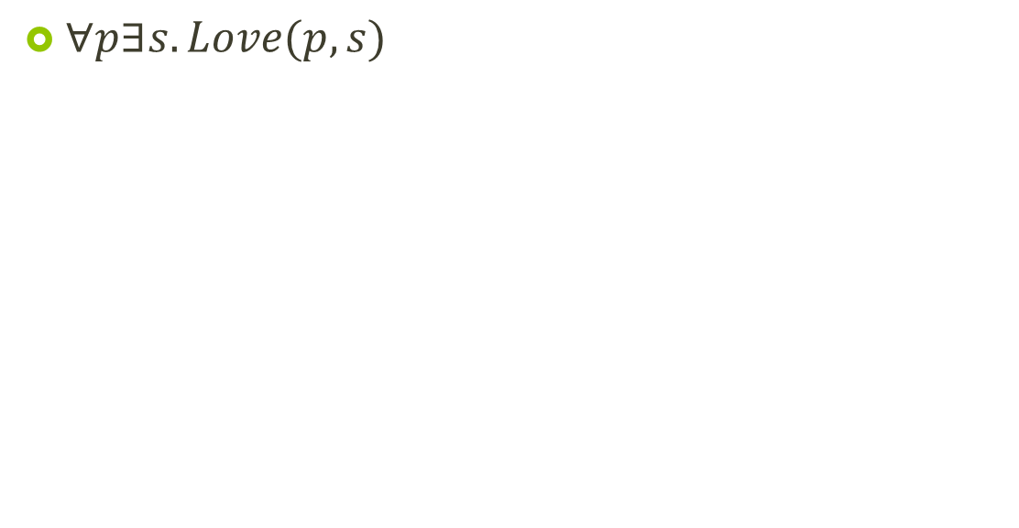
Which picture represents the predicate? (Predicate Love(x,y) means “x loves y”, denoted by arrow from x to y)
ssss
A.
B.
C.
D. None/more/other

Slide 7
Which picture represents the predicate? (Predicate Love(x,y) means “x loves y”, denoted by arrow from x to y)
A.
B.
C.
D. None/more/other

Slide 8
Proof strategies overview (more coming later in the quarter)
For a universally quantified (“for all”) statement:
To prove it:
Mathematical induction, direct proof, generalization from the generic particular (construction)
To disprove it:
Provide a single counterexample
For an existentially quantified (“there exists”) statement:
To prove it:
Provide a single example
To disprove it:
State the correct version as a universally quantified statement (“For all x, not P(x)”) then prove it using above methods

Slide 9
How could we disprove the predicate? (Predicate Love(x,y) means “x loves y”)
$∀p∃s. Love(p,s)$
By counterexample: show there is a person who loves everyone
By counterexample: Show there is a person who loves no one
By counterexample: Show there is a person who nobody loves
By counterexample: Show there is a person who everyone loves
Other/more/none

Slide 10

What is the correct negation of the predicate? (Predicate Love(x,y) means “x loves y”)
$∃s∀p. Love(p,s)$
$∀s∀p. \sim Love\left(p,s\right)$
$∀s∃p. \sim Love(p,s)$
$∃s∀p. \sim Love\left(p,s\right)$
$∀s∃p. \sim Love(s,p)$
Other/more/none

