Slide 1
CSE 105 Theory of Computation
Alexander Tsiatas
Spring 2012
Theory of Computation Lecture Slides by Alexander Tsiatas is licensed under a Creative Commons Attribution-NonCommercial-ShareAlike 3.0 Unported License.
Based on a work at http://peerinstruction4cs.org.
Permissions beyond the scope of this license may be available at http://peerinstruction4cs.org.

Slide 2
Equivalence of Finite Automata NFA & DFA
Another construction proof

Slide 3
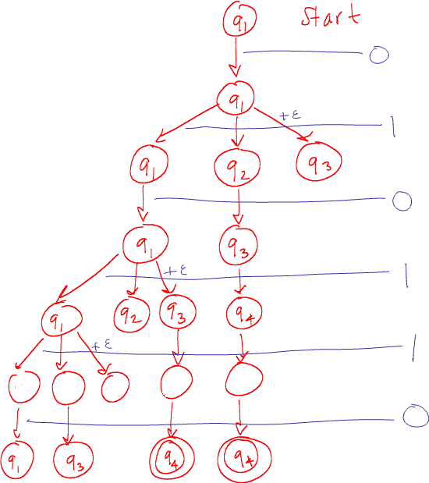
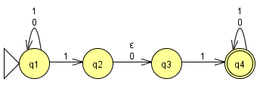
Tracing in NFA
(Fig. 1.27 in your book)
Run this NFA on input 010110
Fill in the missing row of states:
q2, q3, q4, q4, q4
q1, q2, q4, q4, q4
q1, q2, q3, q4, q4
None of the above
I don’t understand this at all

Slide 4
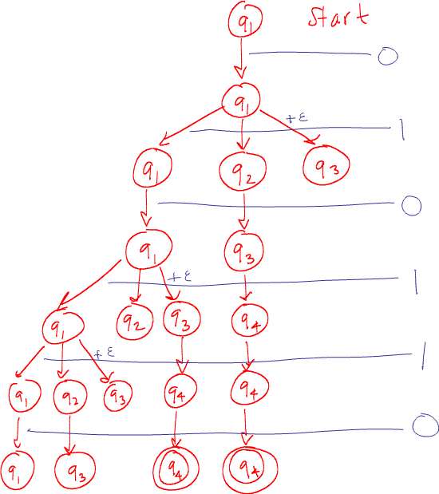
Tracing in NFA
(Fig. 1.27 in your book)
Run this NFA on input 010110
Each row is a set of states that we are in at the “same time”
{q1}
{q1,q2,q3}
{q1,q3}
{q1,q2,q3,q4}
{q1,q3,q4}
Recall that when we did the union closure proof with DFAs, we were always in a pair of states at the “same time”—same concept
What are all the possible unique sets of states?
(a) QxQ (b) |Q|² (c) P(Q) (d) |Q|!
(e) I don’t understand this at all

Slide 5
Thm. 1.39: Every NFA has an equivalent DFA.
Given: NFA M = (Q,Σ,δ,q₀,F)
Want: DFA M’ = (Q’,Σ,δ’,q₀’,F’) s.t. L(M) = L(M’).
Construction: //need to make a DFA that simulates nondeterminism within the constraints of determinism (!!)
Q’ =
Σ
δ’
q₀’ =
F’ =
A DFA recognizes L(M), then every NFA has an equivalent DFA. Q.E.D.
Talk about sigma
P(Q)
d’(R,a) = {q | q in d(r,a) for some r in R OR q can be reached by following 1+ epsilon edges from some r in R}
q’0 = {q0} U {q in Q | q can be reached by following 1+ epsilon edges from q0}
{ R in Q’ | R contains at least one accept state of M}

Slide 6
Thm. 1.39: Every NFA has an equivalent DFA.
We also know every DFA is an NFA.
Corollary of these two facts:
The class of languages recognized by DFAs and the class of languages recognized by NFAs are the same class
The Class of Regular Languages
Nondeterminism does not make automata more powerful!

Slide 7
Regular Expressions Pattern Matching
Extremely useful

Slide 8
From the Reading Quiz
What is the language of a RE?
Let L be the language of this regular expression:
1*0
Which of the following is NOT in L?
0
10
100
111111111111111111111111110
They’re all in L

Slide 9
Regular Expressions in CSE 105
They look like this:
1*0
(1 U 0*)*
(110 U 011)(10 U 01)*(110 U 011)
Not like this:
~/*.pdf
(?:(?:\r\n)?[\t])*(?:(?:(?:[^()<>@,;:\\".\[ \]\000-\031]+(?:(?:(?:\r\n)?[\t])+|\Z|(?=[\ [“()<>@,;:\\".\[\]]))|"(?:[^\"\r\\]|\\.|(?: (?:\r\n)?[ \t]))*"(?:(?:\r\n)?[\t])*)(?:\.( ?:(?:\r\n)?[\t])*(?:[^()<>@,;:\\".\[\]\000-(etc..., over 6000 characters!)
Email address standard

Slide 10
Regular Expressions
Let L be the language of this regular expression:
((a U Ø)⁺b*)*
Which of the following is NOT true of L?
Some strings in L have equal numbers of a’s and b’s
All strings in L have more b’s than a’s
L contains “aaaaaa”
a‘s never follow b’s in any string in L
None or more than one of the above
Empty string, ab, aabb, etc.
Empty string, b, ab
ba
Clarifications: don’t have to take the same string for each iteration in a *.

Slide 11
Regular Expressions
Let L be the language of this regular expression:
aØb*
Which of the following is NOT true of L?
L is the empty set
L contains “a”
aaab is not in L
None or more than one of the above
Concatenation similar to cartesian product; if A is empty, A x B is empty, AB is empty.

Slide 12
Equivalence of models Regular expressions and NFA’s
So that’s why they’re regular expressions

Slide 13
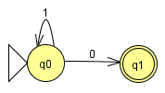
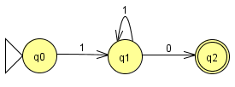
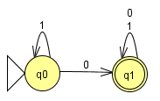
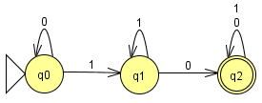
NFA’s and Regular Expressions
Which of the following NFA’s is equivalent to this regular expression?
1*0
a)
c)
b)
d)

Slide 14
NFA’s and Regular Expressions
Which of the following NFA’s is equivalent to this regular expression?
((aa U Ø)⁺b*)*
Ans: b). a) doesn’t do empty string, c/d require 2 aa’s
a)
c)
b)
d)

Slide 15
NFA’s and Regular Expressions
In textbook: Every regular expression has an equivalent NFA
Algorithm to construct NFA
Previous 2 examples generalize
Regular Expression => NFA => DFA
Every regular expression describes a regular language
Ans: b). a) doesn’t do empty string, c/d require 2 aa’s

Slide 16
Equivalence of models Regular expressions and DFA’s
Last equivalence construction

Slide 17
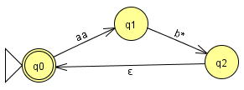
Generalized NFA’s (GNFA’s)
NFA’s, except state transitions have regular expressions instead of single symbols

Slide 18
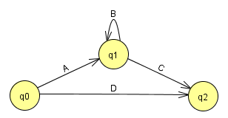
State Elimination
Eliminate state q1. To make an equivalent GNFA, what should go on the edge?
(A, B, C, D are arbitrary regular expressions; this is just a section of a GNFA.)
a) AC b) AC U D c) ABC d) AB*C e) AB*C U D

Slide 19
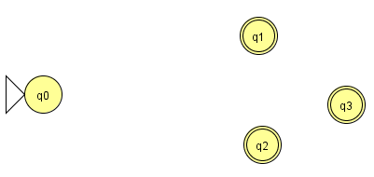
To turn a DFA into a Regular Expression
Add a new start state and accept state with epsilon-transitions
This creates an NFA

Slide 20
To turn a DFA into a Regular Expression
Eliminate states one-by-one, using the technique shown previously
More details: textbook
At the end: a GNFA with 1 start state and 1 accept state.
R is the equivalent regular expression.

Slide 21
What we have shown
Regular languages can be characterized by all three structures:
Next class: languages that are not regular
DFA
NFA
Regular Expression

