Slide 1
CS 106X – Programming Abstractions in C++
CS2 in C++ Peer Instruction Materials by Cynthia Bailey Lee is licensed under a Creative Commons Attribution-NonCommercial-ShareAlike 4.0 International License. Permissions beyond the scope of this license may be available at http://peerinstruction4cs.org.
Cynthia Bailey Lee

Slide 2
Today’s Topics
Course structure and procedures:
Your Grade
My role
Your role
What is this class? What do we mean by “abstractions”?
Next lecture:
Introduce the C++ language from the Java programmer’s perspective
(But it’s ok if you are not a Java programmer)

Slide 3
The Basics: Your Grade
4% Class participation
4% Section participation
20% Midterm
30% Final
42% Programming assignments (6% each)

Slide 4
What do I do in class?
Think of me as your tutor
That means that what I do is:
Be your guide in inducing you to explore concepts
Create situations and pose puzzles that set the scene for your exploration
Answer your questions
Not spend lecture reading the textbook to you with slightly different words

Slide 5
What do you do in class?
(Before class, you prepare yourself by reading the textbook/handouts)
I ask a question
The ideas, not your neighbors

Slide 6
What do you do in class?
(Before class, you prepare yourself by reading the textbook/handouts)
I ask a question
You first answer it by yourself
The ideas, not your neighbors

Slide 7
What do you do in class?
(Before class, you prepare yourself by reading the textbook/handouts)
I ask a question
You first answer it by yourself
Then discuss in assigned groups of 3-4 students
Like a jury, you must come to a unanimous decision
Answer the question a second time
The ideas, not your neighbors

Slide 8
What do you do in class?
(Before class, you prepare yourself by reading the textbook/handouts)
I ask a question
You first answer it by yourself
Then discuss in assigned groups of 3-4 students
Like a jury, you must come to a unanimous decision
Answer the question a second time
I will ask groups to share their insights, and I will provide additional clarification as needed
The ideas, not your neighbors

Slide 9
FAQ: “But Professor Lee, wouldn’t it be more efficient if you just taught us the right answer to begin with?”
Have you ever heard of an aerobics class where the instructor did all the exercises at the front of class, while the class just watched attentively?
Me neither.
To learn, you must do the work with your own muscle (your brain).

Slide 10
What do you do in this course?
Prepare for maximum in-class learning
Reading, reading quizzes
In class: engage with your neighbors and the class, engage with the ideas
Turn them upside down and sideways, think about what common errors or misconceptions might be
Seek help
In class, section, Piazza forum, TA office hours, instructor office hours, LaIR
The ideas, not your neighbors

Slide 11
Who should you be in this course?
Be a professional
Take the time to truly learn and transform yourself into a professional, not “cram” or work for points
Be warm and generous
Be invested in the progress and well-being of your classmates
Be earnest
Let your participation to be characterized by risk-taking and a headlong dive into the activity. Free yourself of the need to withhold part of yourself or remain aloof.
Be honest
Decide today to follow a path of uncompromised integrity in your work in this course and throughout your Stanford career. Envision yourself in the future with the confidence that can only be purchased with a long record of scrupulous decision-making.
The ideas, not your neighbors

Slide 12
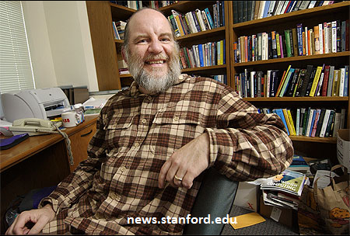
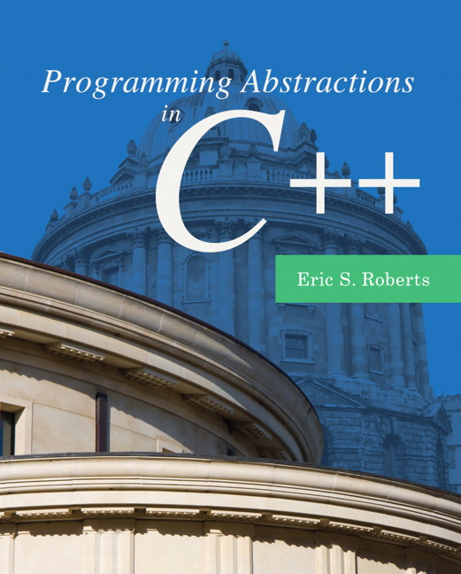
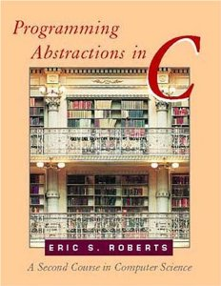
About the textbook
Required textbook:
Programming Abstractions in C++ by Eric Roberts
Prof. Roberts is a faculty member here at Stanford
Note: do not buy C version

Slide 13
What is this class about?
What do we mean by “abstractions”?

Slide 14
http://www.publicdomainpictures.net/pictures/10000/velka/1-1265899974oKJ9.jpg

Slide 15
http://www.publicdomainpictures.net/pictures/10000/velka/1-1265899974oKJ9.jpg

Slide 16
Sentence
Subject
Verb Phrase
Object
Noun
Adverb
Verb
Possessive
Noun
CS106X
totally
rocks
my
socks

Slide 17
CS106X
totally
rocks
my
socks

Slide 18
Building a vocabulary of abstractions
makes it possible to represent and solve a huge variety of problems using known tools.

Slide 19
A first C++ program (ERROR)
firstprogram.cpp
#include <iostream>
#include "console.h"
using namespace std;
int main(){
cout << "|-5| = " << absoluteValue(-5) << endl;
return 0;
}
int absoluteValue(int n) {
if (n<0){
return -n;
}
return n;
}
You don’t know what automata is, do you? SOON!
Notes:
-- firstprogram.cpp : unlike java, filename doesn’t have to match class! In fact, don’t need a class!
-- instead of “import” we have “#include” – note some have “” some have <> -- .h extension means “header” interface information as opposed to .cpp for implementation code
-- “using namespace” just don’t worry about why and use it (saves having to do ::)
-- main returns type int, just return zero if everything went ok (ignore why)
-- we use cout instead of System.out.println(), endl puts a newline

Slide 20
A first C++ program (FIXED 1)
#include <iostream>
#include "console.h"
using namespace std;
int absoluteValue(int n) {
if (n<0){
return -n;
}
return n;
}
int main(){
cout << "|-5| = " << absoluteValue(-5) << endl;
return 0;
}
firstprogram.cpp
You don’t know what automata is, do you? SOON!

Slide 21
A first C++ program (FIXED 2)
#include <iostream>
#include "console.h"
using namespace std;
int absoluteValue(int n);
int main(){
cout << "|-5| = " << absoluteValue(-5) << endl;
return 0;
}
int absoluteValue(int n) {
if (n<0){
return -n;
}
return n;
}
firstprogram.cpp
You don’t know what automata is, do you? SOON!

Slide 22
Question: Why does C++ have the function prototype syntax?
In other words, why not just have a rule that you must set up the ordering so you define your functions before using them, as in the “FIXED 1” example?
C++ could have done that, but such a rule would be cumbersome.
C++ could have done that, but good programming practice dictates “top-down” approach that logically puts main() first and helper functions it calls to follow.
C++ couldn’t have done that—sometimes there is no way to order the functions so that all functions are defined before being used.
All/none/more than one of the above

Slide 23
Question: Why does C++ have the function prototype syntax?
The rationales behind choices (A) and (B) (previous slide) are correct
May or may not have been enough to compel the language designers to introduce the function prototype feature
(C) is true—there are cases where you simply cannot rearrange the ordering of functions to avoid all cases of use before definition
e.g., mutual recursion

Slide 24
Mutual recursion
#include<iostream>
#include "simpio.h"
#include "console.h"
using namespace std;
void go(int n);
void stanford(int n);
int main(){
int n = getInteger("Enter a number of times to repeat: ");
go(n);
return 0;
}
void go(int n) {
if (n == 0) return;
cout << "Go!" << endl;
stanford(n-1);
}
void stanford(int n) {
cout << "Stanford!" << endl;
go(n);
}

