Slide 1
CS 106X – Programming Abstractions in C++
CS2 in C++ Peer Instruction Materials by Cynthia Bailey Lee is licensed under a Creative Commons Attribution-NonCommercial-ShareAlike 4.0 International License. Permissions beyond the scope of this license may be available at http://peerinstruction4cs.org.
Cynthia Bailey Lee

Slide 2
Today’s Topics
Introduce the C++ language from the Java programmer’s perspective
(But it’s ok if you are not a Java programmer)
Foster introspection about good design
Decomposition, reuse, simplification, readability
Serve as an orientation to our expectations for your programming assignments

Slide 3
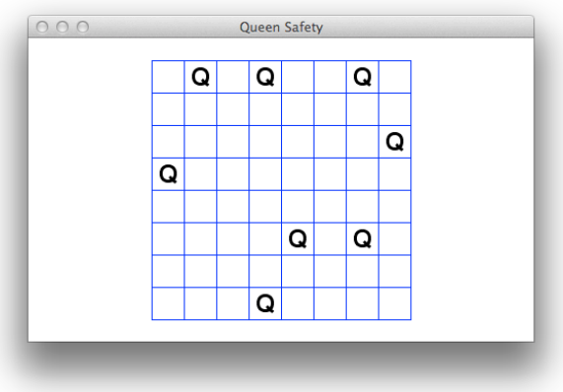
Today’s main example: Queen safety

Slide 4
Queen safety (BUG)
// (includes omitted)
static void clearBoard(Grid<bool> board);
int main(){
Grid<bool> board(8,8);
/* note that clearing here is not
* strictly necessary */
clearBoard(board);
// …more code to come…
return 0;
}
static void clearBoard(Grid<bool> board){
for (int i=0; i<board.numRows(); i++){
for (int j=0; j<board.numCols(); j++){
board[i][j] = false;
}
}
}
The for loops have an off-by-one error on the edges of the grid
Board is declared but not instantiated
The board in main() is not updated
The code is inefficient
All/ none/ more than one of the above
Notes:
-- we don’t need “new” on the Grid<bool>, this actually creates the thing not just declares it! (but it’s on the stack not in the heap)
-- passing the board this way makes a copy and the erasing does nothing

Slide 5
C++ feature: pass by reference
// (includes omitted)
static void clearBoard(Grid<bool> board);
int main(){
Grid<bool> board(8,8);
/* note that clearing here is not
* strictly necessary */
clearBoard(board);
// …more code to come…
return 0;
}
static void clearBoard(Grid<bool>& board){
for (int i=0; i<board.numRows(); i++){
for (int j=0; j<board.numCols(); j++){
board[i][j] = false;
}
}
}

Slide 6
Now consider a function printBoard
Loops over the Grid object and prints all the contents to cout
Unlike clearBoard, it does not modify the board (“read only”)

Slide 7
Which is better?
static void printBoard(Grid<bool>& board){
for (int i=0; i<board.numRows(); i++){
for (int j=0; j<board.numCols(); j++){
cout << board[i][j];
}
cout << endl;
}
}
(A)
static void printBoard(Grid<bool> board){
for (int i=0; i<board.numRows(); i++){
for (int j=0; j<board.numCols(); j++){
cout << board[i][j];
}
cout << endl;
}
}
(B)
(C) Other/none/more than one

Slide 8
Which is better?
static void printBoard(Grid<bool>& board){
for (int i=0; i<board.numRows(); i++){
for (int j=0; j<board.numCols(); j++){
cout << board[i][j];
}
cout << endl;
}
}
ANSWER:
Hard to say!
Efficiency vs. safety is a classic tension in CS.
A better way we’ll learn later: const
(A)
static void printBoard(Grid<bool> board){
for (int i=0; i<board.numRows(); i++){
for (int j=0; j<board.numCols(); j++){
cout << board[i][j];
}
cout << endl;
}
}
(B)
(C) Other/none/more than one

Slide 9
Handy loop idiom: iterating over neighbors in a Grid
static bool isSafe(Grid<bool>& board, int row, int col) {
for (int drow = -1; drow <= 1; drow++) {
for (int dcol = -1; dcol <= 1; dcol++) {
if (!isDirectionSafe(board, row, col, drow, dcol)) {
return false;
}
}
}
return true;
}
These nested for loops generate all the pairs in the cross product {-1,0,1} x {-1,0,1}, and we can add these as offsets to a (row,col) coordinate to generate all the neighbors (note: often want to test for and exclude the (0,0) offset, which is our self)

Slide 10
Stanford library random number utilities
static void placeRandomQueens(Grid<bool>& board) {
int numQueensPlaced = 0;
while (numQueensPlaced < kNumQueens) {
int row = randomInteger(0, board.numRows() - 1);
int col = randomInteger(0, board.numCols() - 1);
if (!board[row][col]) {
board[row][col] = true;
numQueensPlaced++;
}
}
}
There are other functions in addition to randomInteger, they are pretty self-explanatory. See reference web page.

Slide 11
Handy loop idiom: edge detection example
/* Returns true if the pixel at row,col is on an edge. */
static bool isEdge(Grid<Pixel>& board, int row, int col, int threshold) {
for (int drow=row-1; drow<=row+1; drow++) {
for (int dcol=col-1; dcol<=col+1; dcol++) {
if (difference(board[row,col],board[drow,dcol]) > threshold)
{
return true;
}
}
}
return false;
}

Slide 12
ADTs
Notes:
-- Lend an intuitive, readable quality to code by capturing useful analogies about how we collect and access data

Slide 13
ADTs
Programming language independent models of common containers
They encompass not only the nature of the data, but ways of accessing it
They form a rich vocabulary of nouns and verbs, often drawing on analogies to make their use intuitive, and to give code written in them a certain literary quality

Slide 14
ADTs implemented in the Stanford Library
Vector
Grid
Graph
Map (and HashMap)
Set (and HashSet)
Map
PriorityQueue
Queue

Slide 15
ADT: Grid
queensafety.cpp
#include <iostream>
#include "console.h"
#include "grid.h"
using namespace std;
static void clearBoard(Grid<bool>& board);
int main(){
Grid<bool> board(8,8);
clearBoard(board);
// …more code to come…
return 0;
}
static void clearBoard(Grid<bool>& board){
for (int i=0; i<board.numRows(); i++){
for (int j=0; j<board.numCols(); j++){
board[i][j] = false;
}
}
}
Notes:
-- Each element in our Grid is a single boolean (note for Java programmers: in C++ we abbreviate bool)
-- We could, say, represent all the pieces by changing to Grid<int>, and then making a code using const variables (e.g. “const int PAWN=1; const int ROOK=2;” etc), or better an enum which does a similar thing automatically.
-- The way the <Type> syntax works is that all the code for the container class is written with the generic Type used. Then clients of this specify which one it is when it is being used (Grid<bool> or Grid<int> etc).

