Slide 1
CS 106X – Programming Abstractions in C++
CS2 in C++ Peer Instruction Materials by Cynthia Bailey Lee is licensed under a Creative Commons Attribution-NonCommercial-ShareAlike 4.0 International License. Permissions beyond the scope of this license may be available at http://peerinstruction4cs.org.
Cynthia Bailey Lee

Slide 2
CS106X: Today’s Topics
Recursion!!!
Binary search (continued)
Fractals

Slide 3
Binary Search (continued)

Slide 4
Binary search
0 | 1 | 2 | 3 | 4 | 5 | 6 | 7 | 8 | 9 | 10
2 | 7 | 8 | 13 | 25 | 29 | 33 | 51 | 89 | 90 | 95
Let’s say the answer was 3, “we didn’t go far enough”
We ruled out the entire first half, and now only have the second half to search
We could start at the front of the second half and proceed forward…but why do that when we know we have a better way?
Jump right to the middle of the region to search

Slide 5
Binary search
0 | 1 | 2 | 3 | 4 | 5 | 6 | 7 | 8 | 9 | 10
2 | 7 | 8 | 13 | 25 | 29 | 33 | 51 | 89 | 90 | 95
Let’s say the answer was 3, “we didn’t go far enough”
We ruled out the entire first half, and now only have the second half to search
We could start at the front of the second half and proceed forward…but why do that when we know we have a better way?
Jump right to the middle of the region to search
RECURSION!!

Slide 6
To write a recursive function, we need base case(s) and recursive call(s)
What would be a good base case for our Binary Search function?
Only three items remain: save yourself an unnecessary function call that would trivially divide them into halves of size 1, and just check all three.
Only two items remain: can’t divide into two halves with a middle, so just check the two.
Only one item remains: just check it.
No items remain: obviously we didn’t find it.
More than one

Slide 7
Binary Search
bool binarySearch(Vector<int>& data, int key){
return binarySearch(data, key, 0, data.size()-1);
}
bool binarySearch(Vector<int>& data, int key,
int start, int end){
// Write code to handle the base case “No items remain:
// obviously we didn’t find it” by returning false
if (data.size() <= 0) return false;
if (end < start) return false;
if (end == start) return false;
Other/none/more
//to be continued…
}

Slide 8
Binary Search
bool binarySearch(Vector<int>& data, int key){
return binarySearch(data, key, 0, data.size()-1);
}
bool binarySearch(Vector<int>& data, int key,
int start, int end){
if (end < start) return false;
int mid = (start + end)/2;
if (data[mid] == key) return true;
else if (data[mid] > key) {
return binarySearch(data,key,mid+1,end);
return binarySearch(data,key,mid,end-1);
return binarySearch(data,key,start,mid-1);
Other/none/more
}
// to be continued…
}

Slide 9
Binary Search
bool binarySearch(Vector<int>& data, int key){
return binarySearch(data, key, 0, data.size()-1);
}
bool binarySearch(Vector<int>& data, int key,
int start, int end){
if (end < start) return false;
int mid = (start + end)/2;
if (data[mid] == key) return true;
else if (data[mid] > key)
return binarySearch(data,key,start,middle-1);
else
return binarySearch(data,key,middle+1,end);
}

Slide 10
Binary Search: arm’s length recursion
bool binarySearch(Vector<int>& data, int key){
return binarySearch(data, key, 0, data.size()-1);
}
bool binarySearch(Vector<int>& data, int key,
int start, int end){
if (end < start) return false;
if (end == start && data[end] == key) return true;
if (start == end-1 && (data[start] == key || data[end] == key))
return true;
int mid = (start + end)/2;
if (data[mid] == key) return true;
else if (data[mid] > key)
return binarySearch(data,key,start,middle-1);
else
return binarySearch(data,key,middle+1,end);
}

Slide 11
Boxy Snowflake Fractal

Slide 12
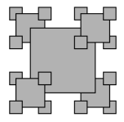
Boxy Snowflake example
static const double SCALE = 0.45;
static void drawFractal(GWindow& window, double cx, double cy,
double dim, int order) {
if (order >= 0) {
drawFractal(window, cx-dim/2, cy+dim/2, SCALE*dim, order-1);
drawFractal(window, cx+dim/2, cy-dim/2, SCALE*dim, order-1);
drawFractal(window, cx-dim/2, cy-dim/2, SCALE*dim, order-1);
drawFractal(window, cx+dim/2, cy+dim/2, SCALE*dim, order-1);
}
}
Where should this line of code be inserted to
produce the pattern shown?
drawFilledBox(window, cx, cy, dim, "Gray", "Black");
(A) Insert it here
(B) Insert it here
(C) Insert it here
(D) Insert it here
(E) None of the above

Slide 13
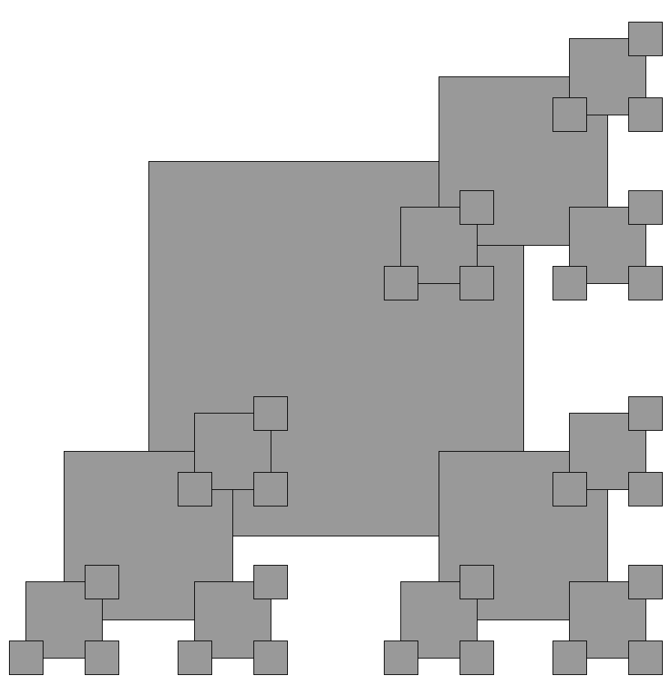
Variants: How can we code this?

Slide 14
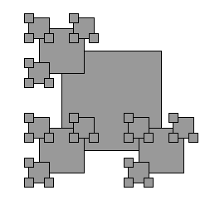
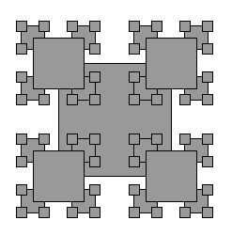
Real or photoshop?
Can these be made by changing the order of lines and/or deleting lines in the draw function?
(1) (2)
(A) 1 is real (B) 2 is real (C) Both are ‘shopped (D) Both are real

