Slide 1
CS106X – Programming Abstractions in C++
CS2 in C++ Peer Instruction Materials by Cynthia Bailey Lee is licensed under a Creative Commons Attribution-NonCommercial-ShareAlike 4.0 International License. Permissions beyond the scope of this license may be available at http://peerinstruction4cs.org.
Cynthia Bailey Lee

Slide 2
Today’s Topics
Quick P/NP vocabulary
Just how slow is O(2^{n})?
We can’t afford to just not solve problems that are NP-hard. So what can we do?

Slide 3
Quick P/NP definitions
P and NP are sets of problems

Slide 4
Quick P/NP definitions
P and NP are sets of problems
A problem is “in P” if it can be solved in polynomial time* *on a deterministic Turning machine—take CS103!
Ex: an algorithm exists that solves it in O(n⁵)
A problem is “in NP” if we could answer the question in polynomial time IF we had unlimited parallelism and/or omniscient guessing of what to do next at key decision junctures* *this is a non-deterministic Turning machine—take CS103!

Slide 5
Quick P/NP definitions
P and NP are sets of problems
A problem is “in P” if it can be solved in polynomial time* *on a deterministic Turning machine—take CS103!
Ex: an algorithm exists that solves it in O(n⁵)
A problem is “in NP” if…
If P ≠ NP, then all you need to know is that problems in NP (and not in P) take at least O(2^{n}) time on reasonable computers that actually exist

Slide 6
Decision vs Optimization
For the purposes of this class, we will consider both of these kinds of problems:
Decision problem
Ex: “Is there a route through all 64 cities with total length <= k?”
Optimization problem
Ex: “What is the smallest total length route through all 64 cities?”
(I mention this distinction because, in complexity theory, these two categories are often treated separately)

Slide 7
Just how slow is O(2^{n})?
(Review from earlier this quarter, when we talked about naïve recursion Fibonacci vs recursion with memoization.)

Slide 8
Context
Computers today are unbelievably fast
This (relatively weak) tablet can do 2.4 billion operations per second! Wow!
So if we really need to know the answer to an NP-hard question, can’t we just wait a while? Let it run overnight?

Slide 9
log₂n | n | n log₂n | n² | 2^{n}
2 | 4 | 8 | 16 | 16
3 | 8 | 24 | 64 | 256
4 | 16 | 64 | 256 | 65,536
5 | 32 | 160 | 1,024 | 4,294,967,296
6 | 64 | 384 | 4,096
7 | 128 | 896 | 16,384
8 | 256 | 2,048 | 65,536
9 | 512 | 4,608 | 262,144
10 | 1,024 | 10,240 (.000003s) | 1,048,576 (.0003s)
30 | 1,100, 000,000 | 33038341600 (11s) | 1210000000000000000 (403333333s = 767 years)
1.43 seconds
Easy!

Slide 10
log₂n | n | n log₂n | n² | 2^{n}
2 | 4 | 8 | 16 | 16
3 | 8 | 24 | 64 | 256
4 | 16 | 64 | 256 | 65,536
5 | 32 | 160 | 1,024 | 4,294,967,296
6 | 64 | 384 | 4,096 | 1.84 x 10¹⁹
7 | 128 | 896 | 16,384
8 | 256 | 2,048 | 65,536
9 | 512 | 4,608 | 262,144
10 | 1,024 | 10,240 (.000003s) | 1,048,576 (.0003s)
30 | 1,100, 000,000 | 33038341600 (11s) | 1210000000000000000 (403333333s = 767 years)
Easy!
1.43s
194 YEARS
NOT easy!

Slide 11
log₂n | n | n log₂n | n² | 2^{n}
2 | 4 | 8 | 16 | 16
3 | 8 | 24 | 64 | 256
4 | 16 | 64 | 256 | 65,536
5 | 32 | 160 | 1,024 | 4,294,967,296
6 | 64 | 384 | 4,096 | 1.84 x 10¹⁹
7 | 128 | 896 | 16,384
8 | 256 | 2,048 | 65,536
9 | 512 | 4,608 | 262,144
10 | 1,024 | 10,240 (.000003s) | 1,048,576 (.0003s)
30 | 1,100, 000,000 | 33038341600 (11s) | 1210000000000000000 (403333333s = 767 years)
1.43s
194 YEARS
Remember the Marble Game, where you exhaustively tried all possible sequences of moves? There were 32 marbles, so that game was right at the edge of the cliff in terms of being solvable.

Slide 12
log₂n | n | n log₂n | n² | 2^{n}
2 | 4 | 8 | 16 | 16
3 | 8 | 24 | 64 | 256
4 | 16 | 64 | 256 | 65,536
5 | 32 | 160 | 1,024 | 4,294,967,296
6 | 64 | 384 | 4,096 | 1.84 x 10¹⁹
7 | 128 | 896 | 16,384 | 3.40 x 10³⁸
8 | 256 | 2,048 | 65,536 | 1.16 x 10⁷⁷
9 | 512 | 4,608 | 262,144
10 | 1,024 | 10,240 (.000003s) | 1,048,576 (.0003s)
30 | 1,100, 000,000 | 33038341600 (11s) | 1210000000000000000 (403333333s = 767 years)
For comparison: there are about 1.0E+80 atoms in the universe. No big deal.

Slide 13
log₂n | n | n log₂n | n² | 2^{n}
2 | 4 | 8 | 16 | 16
3 | 8 | 24 | 64 | 256
4 | 16 | 64 | 256 | 65,536
5 | 32 | 160 | 1,024 | 4,294,967,296
6 | 64 | 384 | 4,096 | 1.84 x 10¹⁹
7 | 128 | 896 | 16,384 | 3.40 x 10³⁸
8 | 256 | 2,048 | 65,536 | 1.16 x 10⁷⁷
9 | 512 | 4,608 | 262,144 | 1.34 x 10¹⁵⁴
10 | 1,024 | 10,240 (.000003s) | 1,048,576 (.0003s) | 1.80 x 10³⁰⁸
30 | 1,100, 000,000 | 33038341600 (11s) | 1210000000000000000 (403333333s = 767 years)
LOL

Slide 14
So what do we do now?

Slide 15
Current options
Use an approach that finds progressively better and better solutions over time, and let it run as long as you can
Use a randomized approach: make randomized choices and hope for the best
Use a “greedy” approach: at each juncture, make what looks to be the best choice for the immediate future (may not be in the big picture) and hope for the best
Maybe your specific input data has certain properties that make it easier to solve

Slide 16
These options are not as terrible as you might think
For some NP-hard optimization problems, a greedy approach can be guaranteed to find a solution that is “close to” the best possible solution
Greedy (polynomial-time) algorithms can be provably optimal for inputs with specific properties
These properties are not uncommon in some settings (ex: Directed, Acyclic Graph (“DAG”) as a special case of general Graphs)

Slide 17
Discussion:
Can you describe properties of instances of the Traveling Salesperson Problem that would make the instance provably easy to solve?

Slide 18
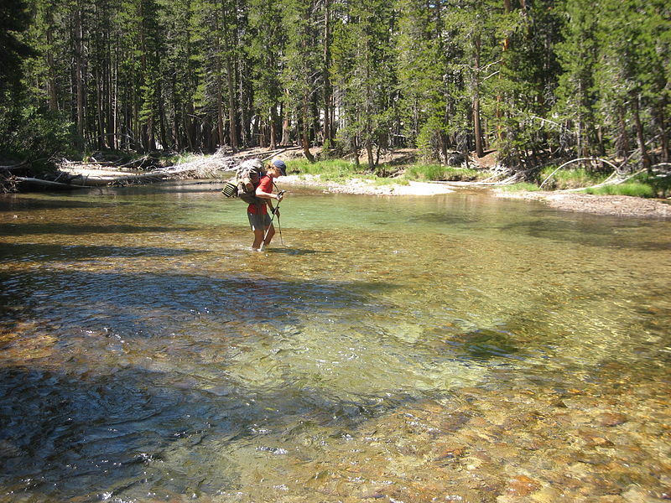
Knapsack problem
You are packing for a backpacking trip on the John Muir trail, and your pack has capacity W kg
You have several items you’d like to bring, each one has an associated
Weight wi in kg
Value vi (say in units of happiness that item will bring you)
Which items should you pack to maximize your happiness?
This file is licensed under the Creative Commons Attribution 2.0 Generic license.
http://commons.wikimedia.org/wiki/File:John_Muir_Trail.jpg
You are free:to share – to copy, distribute and transmit the work to remix – to adapt the work Under the following conditions:attribution – You must attribute the work in the manner specified by the author or licensor (but not in any way that suggests that they endorse you or your use of the work).

Slide 19
Knapsack
Max capacity: 20kg
Items (w_{i},v_{i}): 0: (4,2), 1:(1,1), 2:(5,3), 3:(5,5), 4:(3,4), 5:(15,14), 6:(3,6), 7:(6,8), 8:(10, 12), 9:(8,8)
What do you bring?
1,4,6,0,3 (lightest first)
5,6,1 (highest value--that fits--first)
4,6,7,9 (guess the tactic)
Other

Slide 20
Knapsack is NP-Hard
That means it is only solvable in polynomial time if P=NP
However, knapsack has some attractive shortcuts to full optimization

Slide 21
Knapsack: unbounded version
Assume you can take as many copies as you want of each item
“Pretty good” solution:
Sort items in decreasing order of v_{i}/w_{i}
Take as many copies as you can of an item (until you are limited by weight capacity)
Then take as many copies as you can of the next item, and so on

Slide 22
Knapsack: unbounded version
Assume you can take as many copies as you want of each item
“Pretty good” solution:
Sort items in decreasing order of v_{i}/w_{i}
Take as many copies as you can of an item (until you are limited by weight capacity)
Then take as many copies as you can of the next item, and so on
No worse than half the best solution

Slide 23
Knapsack regular version
There are polynomial-time approximation algorithms that are guaranteed to find a solution that is “close to” the optimal solution
The solution is within (1-ε) factor of the optimal solution

Slide 24
Famous NP-hard Problems
Clique
Independent Set
Vertex Cover
Set Cover
Traveling salesman
Sudoku
Graph coloring
Super Mario Brothers
Subset sum
…
http://en.wikipedia.org/wiki/List_of_NP-complete_problems

Slide 25
NP-complete problems
There are hundreds of these problems that can be used to solve each other with a polynomial-time transformation
Many are in critical application areas (airline flight scheduling, truck shipping route planning, networking, cryptography)
But the best known solutions to all of these take exponential time – O(2^{n}) – TERRIBLE!!

Slide 26
How to win ONE. MILLION. DOLLARS. //evil laugh//
Find a polynomial time function for any one of these
Remember, then it follows that we have a polynomial time function for all, because we can transform the others and then call the fast function
PS: you will have broken all public-key encryption
OR
Prove that no such function exists

Slide 27
A* search
A* search solves Super Mario Brothers
https://www.youtube.com/watch?feature=player_embedded&v=DlkMs4ZHHr8

